Slide 1
BLUE EYES TECHNOLOGY
Sivashalini.C,
20BCR045,
Bsc-Computer System and Design(CSD),
Kongu engineeringcollege,perundurai,
Erode,638060.

Slide 2
Abstract:
The world of science cannot be measured in terms of development and progress.
It shows how far human mind can work and think.
It has now reached to the technology known as “Blue eyes technology”.
It can sense and control human emotions and feelings through gadgets.

Slide 3
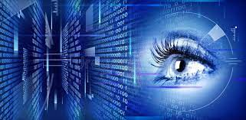
Introduction:
The “Blue eyes technology” works on Artificial Intelligence.
It aims to give human abilities to a computer.
The machine can naturally interact with human beings as through speech, facial expressions and touch.
It is conducted by the research team of IBM at Almand Research Institute(ARC),California since 1997.

Slide 4
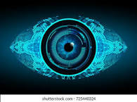
Methodology:
The BLUE EYES technology aims at making machine that have sensory activity and sensory ability like those of people in general.
Also using hottest video cameras and microphone the employmenters actions.

Slide 5
Advantages
Disavantages
Detect the human feelings through a device.
It can understand our mood and feelings.
React to our commands given by the user.
Human can collaborated to systems.
It is not 100 percent accurate.
It is very expensive.
Distraction while reading
Reliability of the system

Slide 6
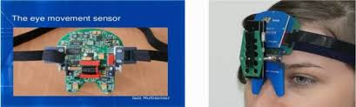
Result:
The “Blue Eyes Technology”can detect the human feelings through a device.
It can detect a feeling by eyes, speech recognition, it can also understand our mood and feelings.
It can also react to our commands given by the user.

Slide 7
Conclusion:
In the future,ordinary “house hold devices”.
Future applications of Blue Eyes Technology are limitless.
Many resereachers are trying to implement this technology.
References:
International Journal of Advance Research In Science And Engineering IJARSE, Vol.No.4,Special Issue (01), April 2015 .
www.wherisdoc.com.
S. Madhumitha, Slide Share, Blue Eyes Technology, Marcp013,

